Slide 1


Psychophysiological Measures for Social Research
Put your Heart, Eyes, and Skin on your Research

Slide 2





Slide 3
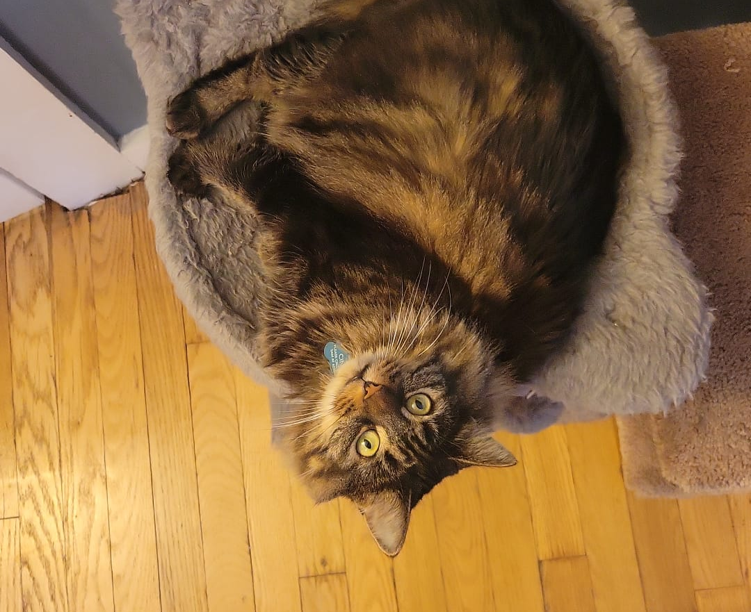
Who’s facilitating today?
Samantha De Leon, MD (sam) she/her
Panamanian/Argentinian ☺
In Cornell University for 3 years now
Pursuing a PhD in Human Development and Psychological Sciences
I research Social Neuroscience and Health in the Life History Lab
sd567@cornell.edu

Slide 4
Agenda
Snacks and swag
Goal Setting
Concepts
The Biosocial Interface and Its Importance
Physiological Measures
Common Measures, Heart, Eyes, and Skin
Technology
Hardware, Software, Language
Evaluation

Slide 5
Goal
Goals
Upon completion participants will:
Be able to assess the relevance of incorporating biological measures into their research.
Be able to assess the methodological challenges of incorporating biological measures into their research.
Have started building a collaborative network towards incorporating biological measures into their research.
What’s your goal?

Slide 6
CONCEPTS

Slide 7

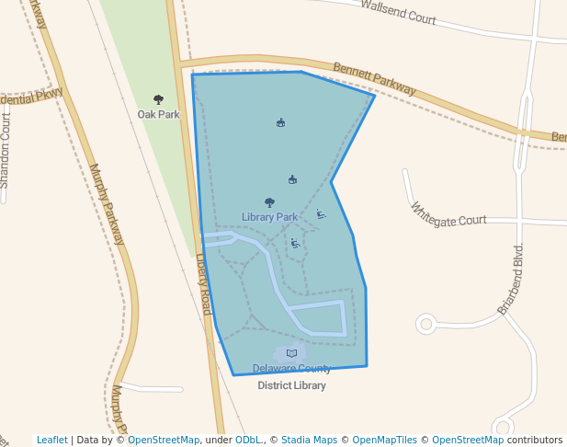

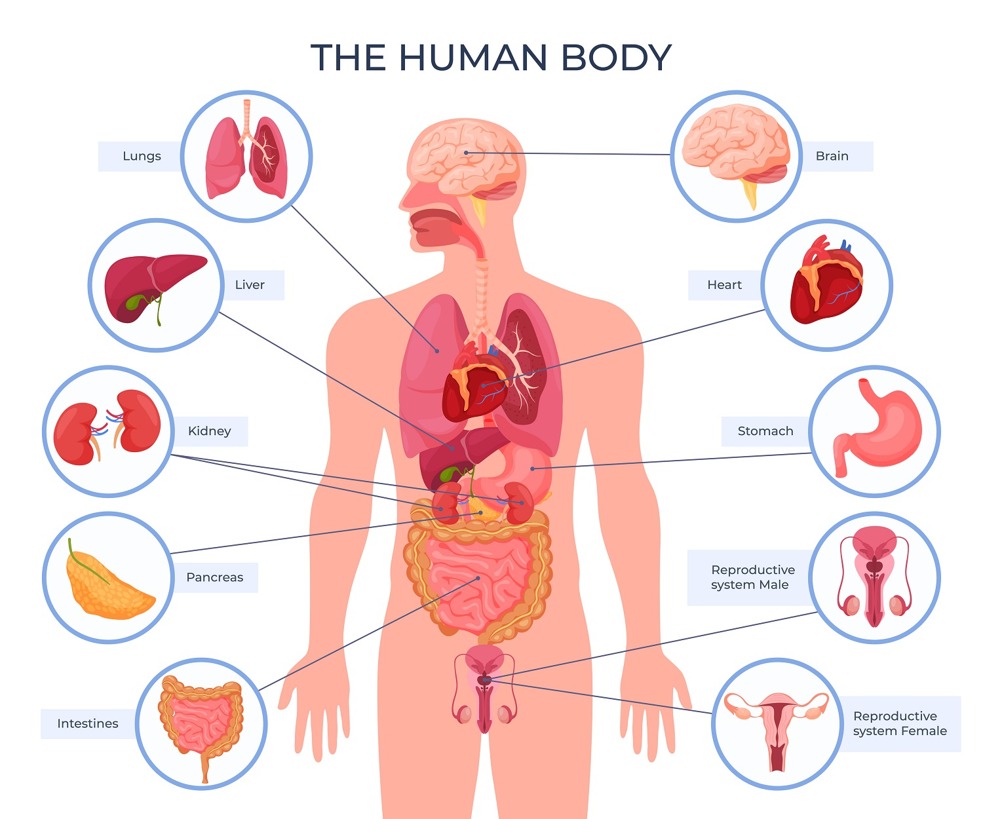


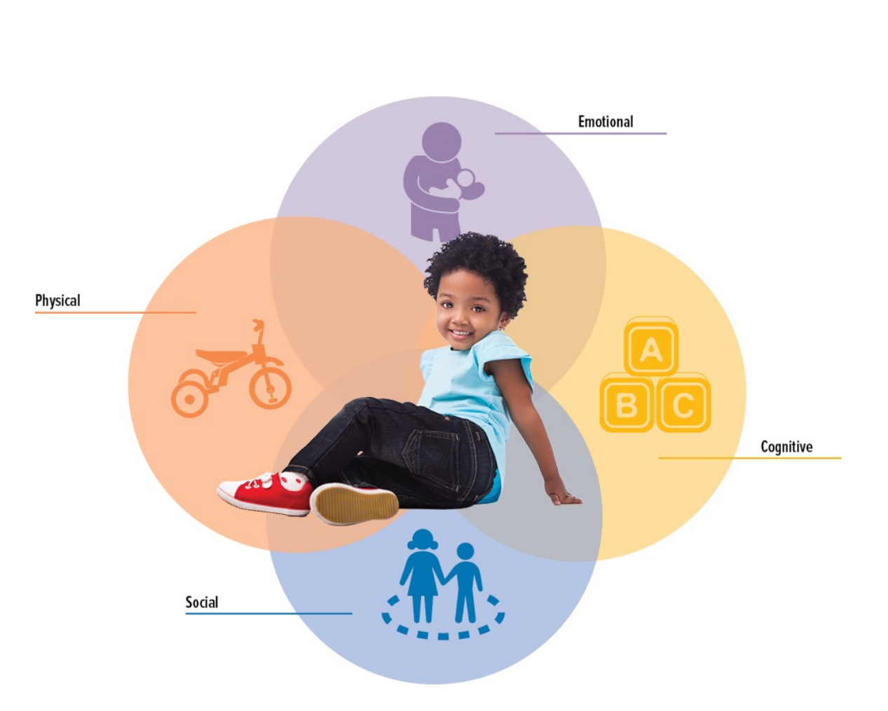
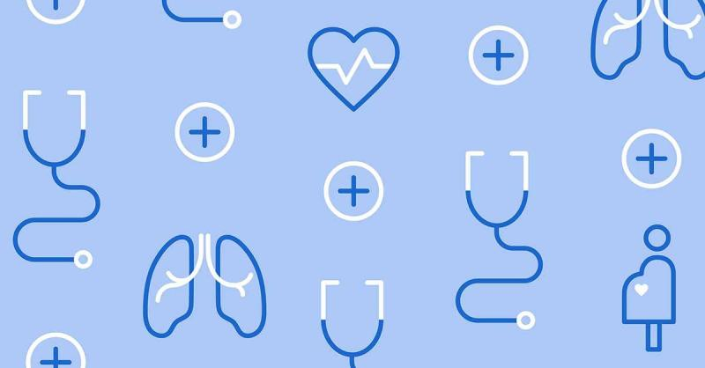
Psychosocial contexts and biological processes
Concepts
Socioeconomic, spatial, and psychosocial contexts
shape developmental trajectories and health outcomes
McDade, T.W., Harris, K.M. From society to cells and back again: new opportunities for discovery at the biosocial interface. Discov Soc Sci Health 2, 4 (2022). https://doi.org/10.1007/s44155-022-00007-z

Slide 8
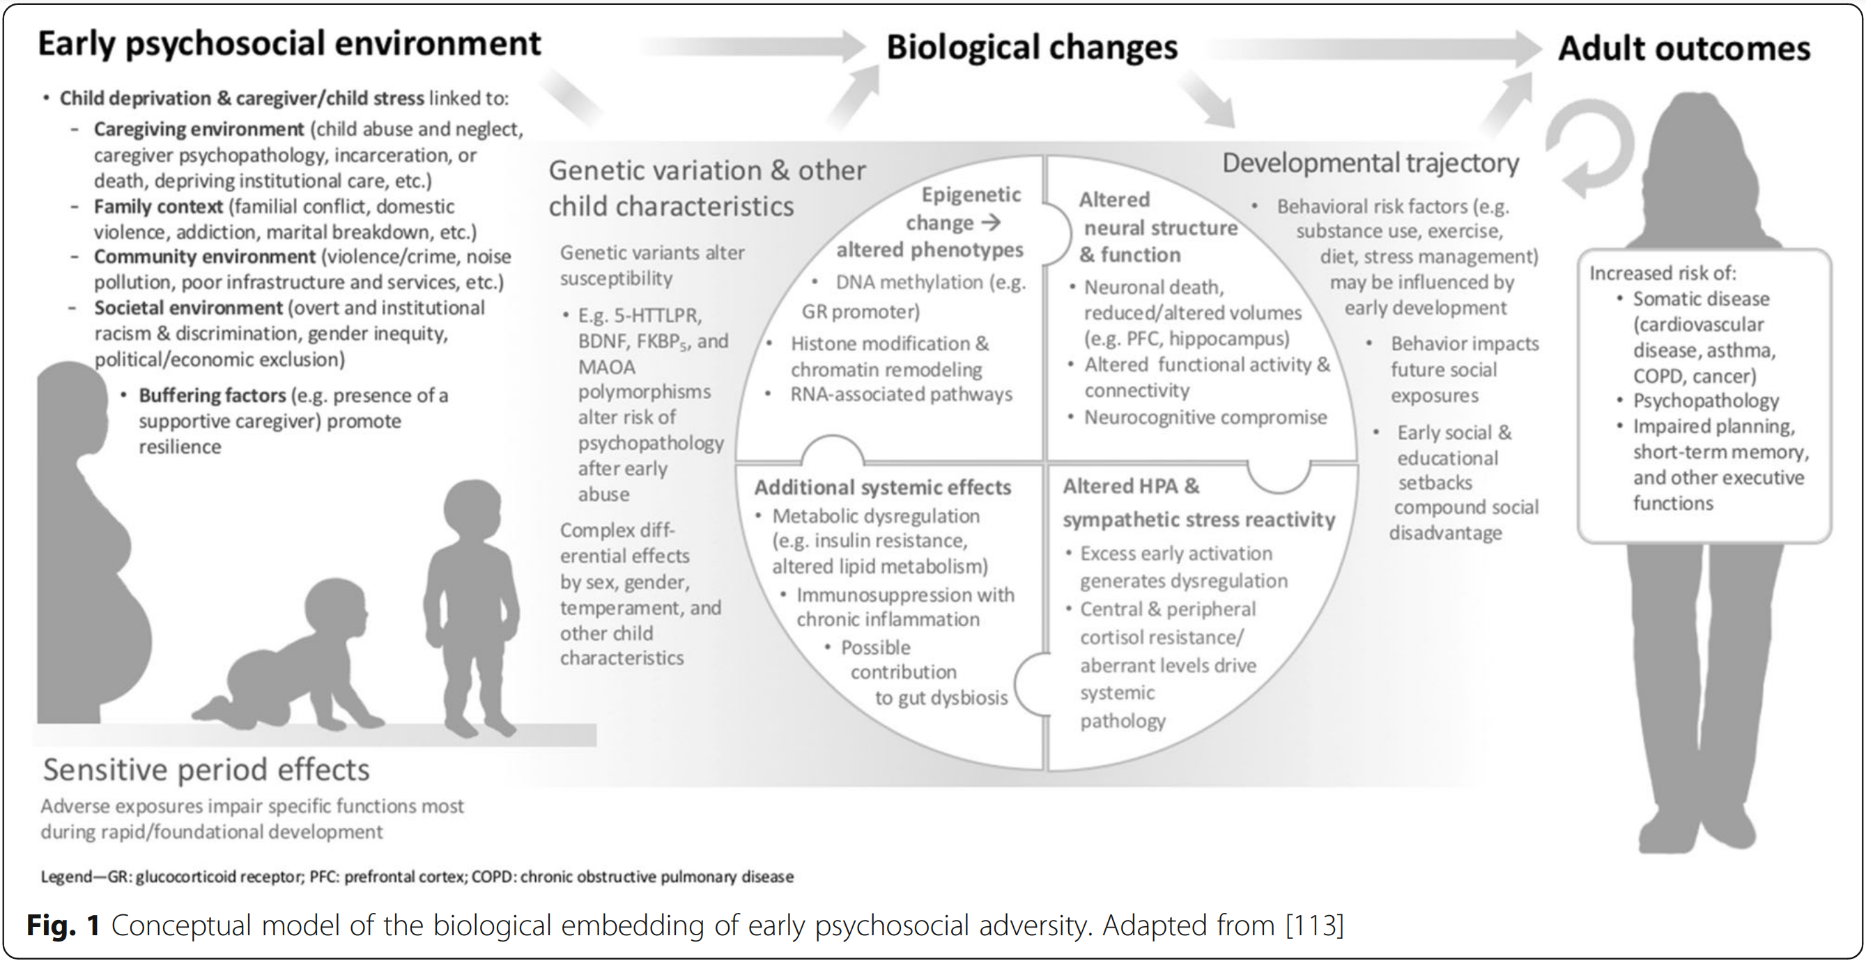

Berens, A.E., Jensen, S.K.G. & Nelson, C.A. Biological embedding of childhood adversity: from physiological mechanisms to clinical implications. BMC Med 15, 135 (2017). https://doi.org/10.1186/s12916-017-0895-4
Notes:
5-HTTLPR (serotonin-transporter-linked promoter region Brain-derived neurotrophic factor (BDNF). Stress can target BDNF in brain regions and circuits that are implicated in disease. BDNF is a downstream intermediary for environmental factors that can lead to anxiety- and depressive-like behaviors, fear memory, sensitivity to stress..
FK506 binding protein 5 s a co-chaperone protein that regulates many cellular processes, including the stress response (modulator of glucocorticoid receptor, glucose homeostasis (tolerance), and protein folding. MAO-A monoaminooxidasa, enzyme that breaks down neurotransmitters DA, norepi, serotonin, brain development before birth, intereacts with childhood abuse to predict substance abuse
Metilar silencia genes (aggression, parent’s internalizing symptoms associate with more methylation in children, neighborhood SE disadvantage and social environment (safety n cohesion) influence dna methylation og genes involved in stress response and inflammation histone (protein that provides structural support fo chromatine) si acetilo una histone, la histora se pliega tightly el DNA y la maquinaria transcriptora no puede acceder al dna y el gen se mantiene inactive.

Slide 9
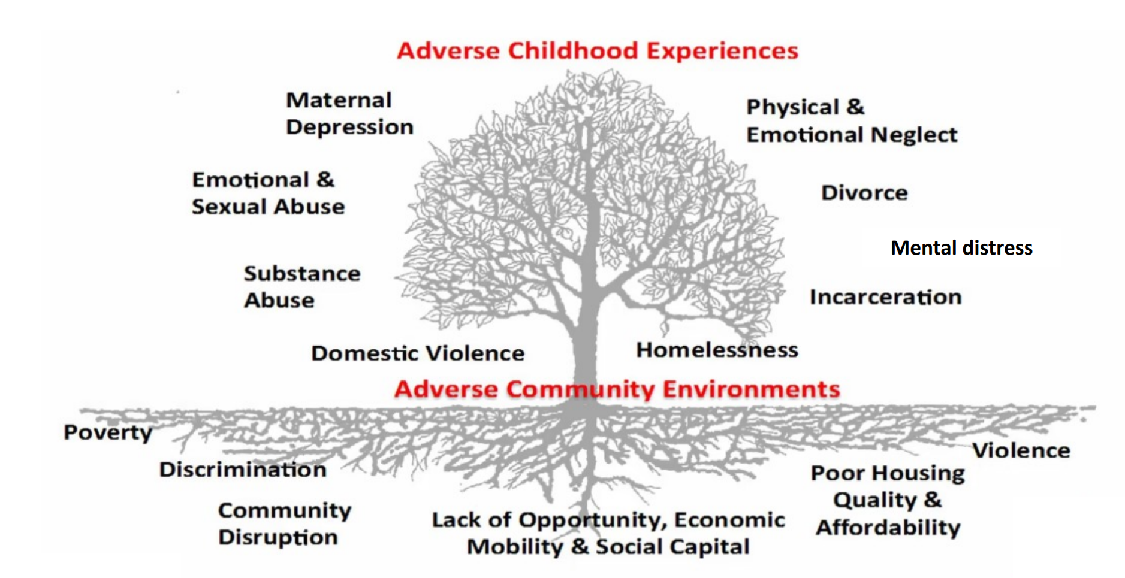
Taken from Farah Qureshi, ScD Assistant Professor Department of Population, Family & Reproductive Health Johns Hopkins Bloomberg School of Public Health July 16, 2024, Life course perspectives in psychosocial epidemiology, Shifting from a deficit orientation to strengths-based models

Slide 10
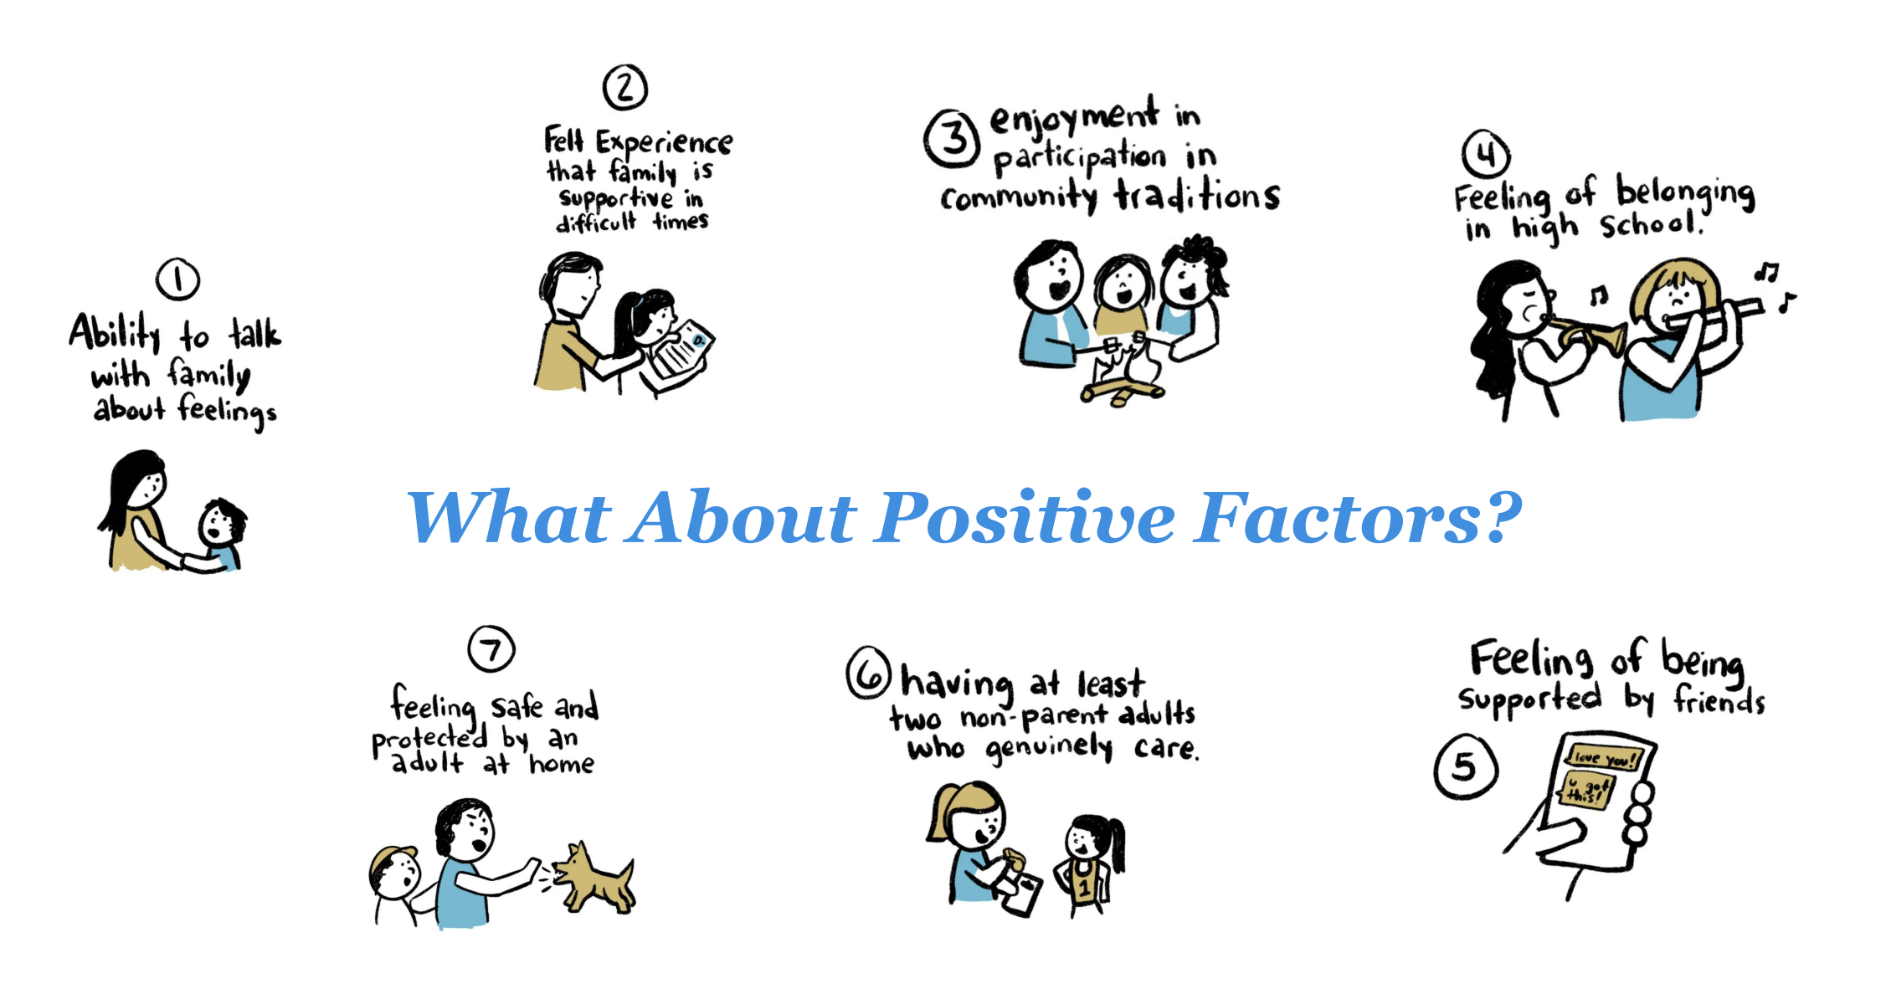
https://lindsaybraman.com/positive-childhood-experiences-aces/

Slide 11
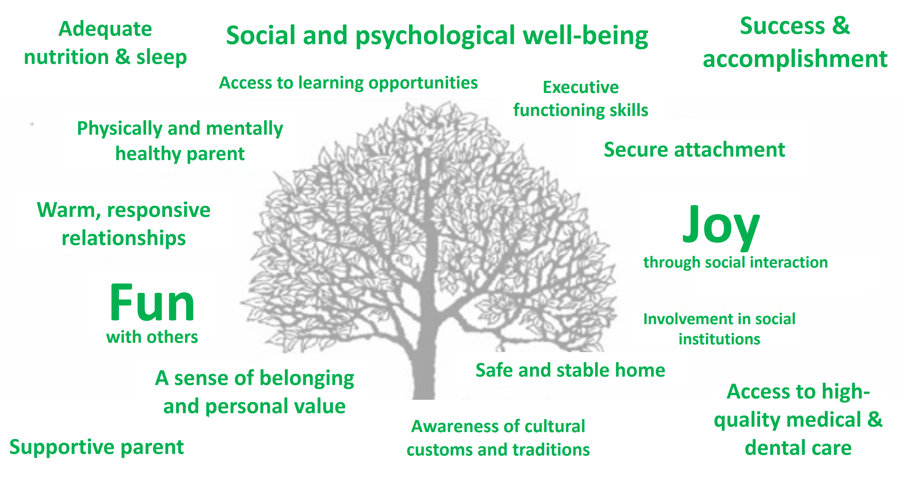
Sege & Browne, 2017. Academic Pediatrics. 17(7): S79-85.
Notes:
Implications for Health Equity • These resources may be particularly beneficial to youth who face structural barriers to health – Racially and ethnically minoritized populations – LGBTQ+ youth – Working class – Immigrant populations • Consistent with emerging evidence that finds PCEs may be most impactful for youth who experience ACES • Important to consider stress buffering in future research

Slide 12
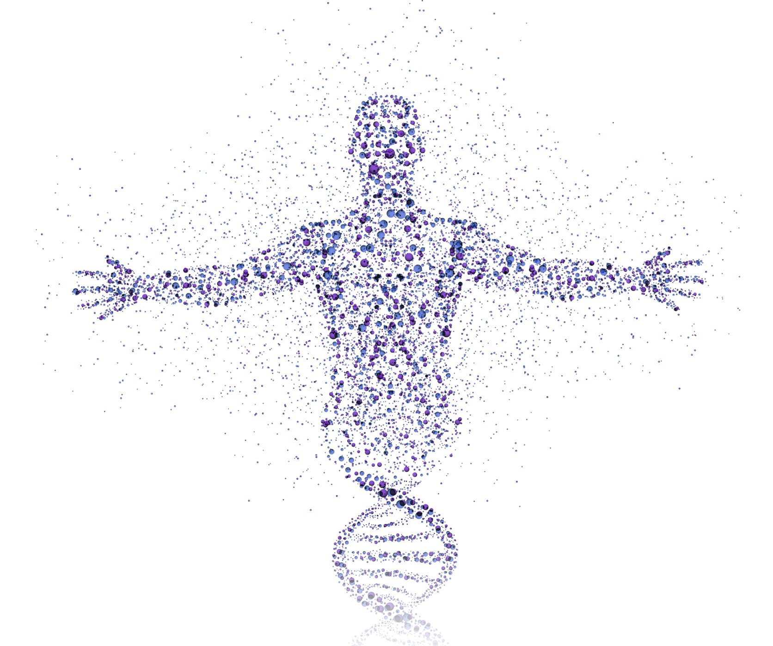
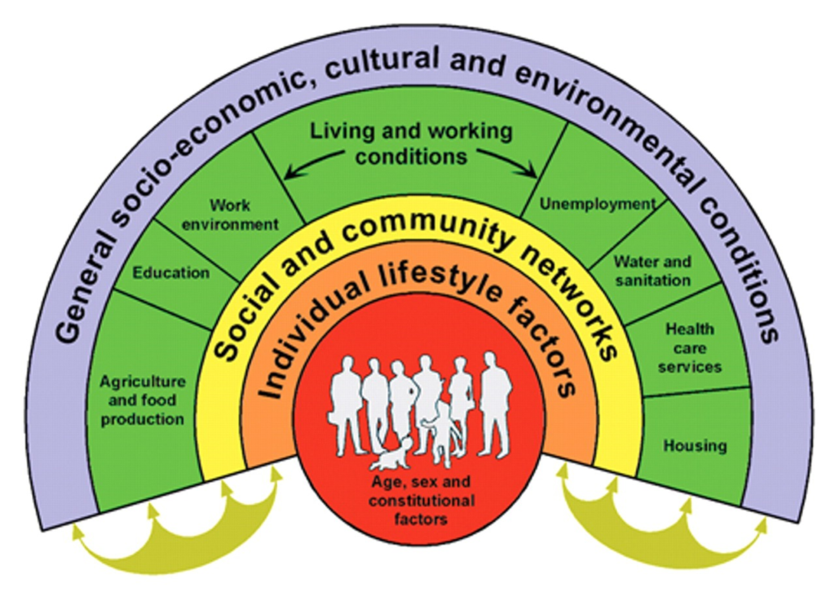
How do psychosocial contexts affect biological processes?
Concepts
Multilevel mechanisms
Macro-structural
Community
Interpersonal
Individual
Pathways
Biological
Genetic
Ascendents exposures
In utero
Epigenetic
Neural
Autonomic
Neuroanatomical
Neurofunctional
Neuroendocrine
Cellular and Subcellular
Aging
Mitochondrial
Cardiovascular
Metabolic
Immune
Behavioral
Parenting Styles
Family functioning
Relational
Diet
Sleep
Exercise
Emotion Regulation

Slide 13
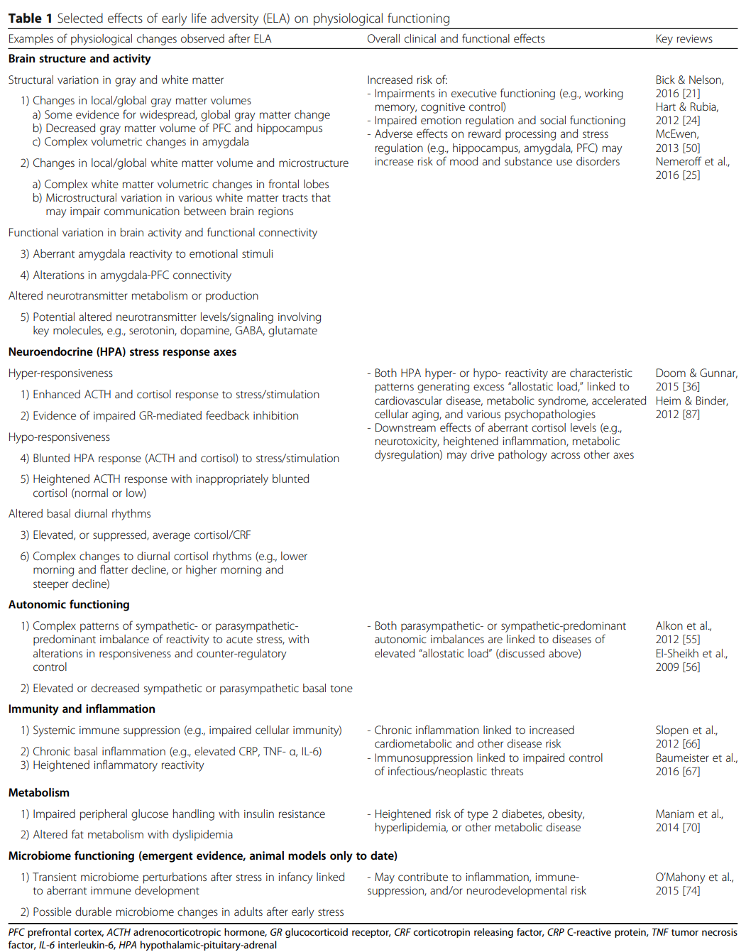
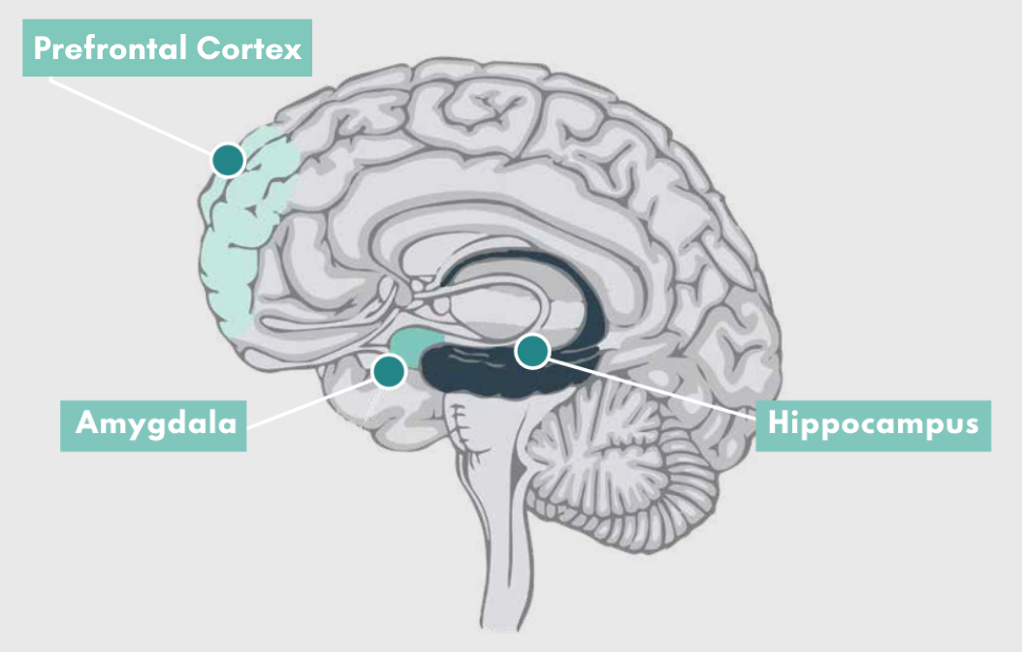
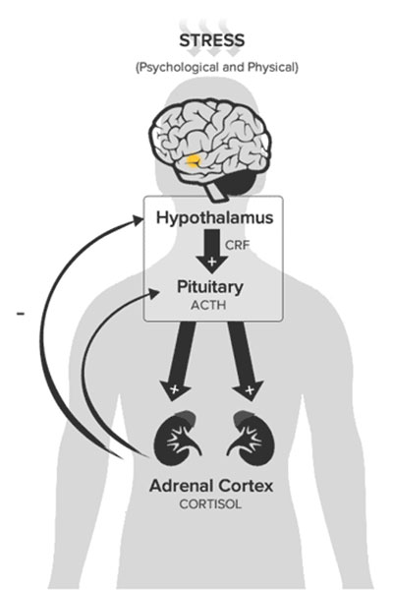
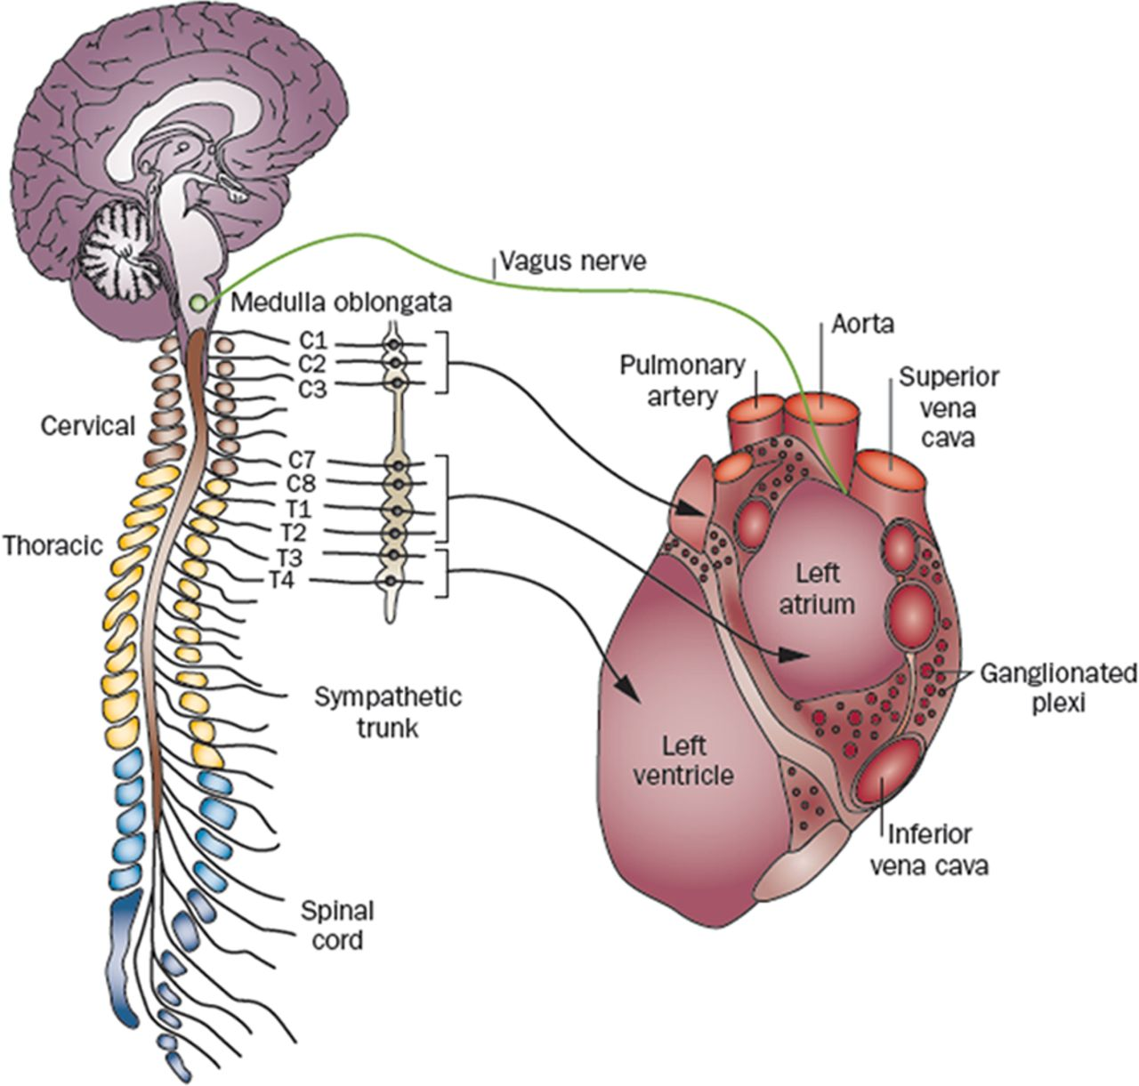
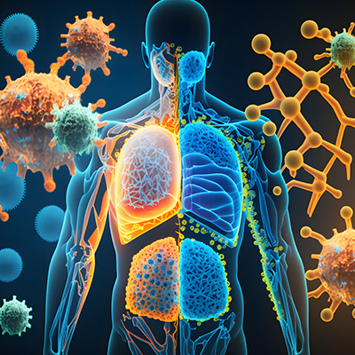
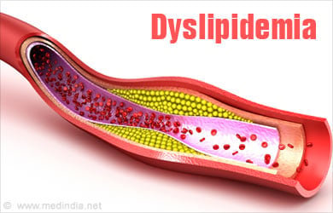
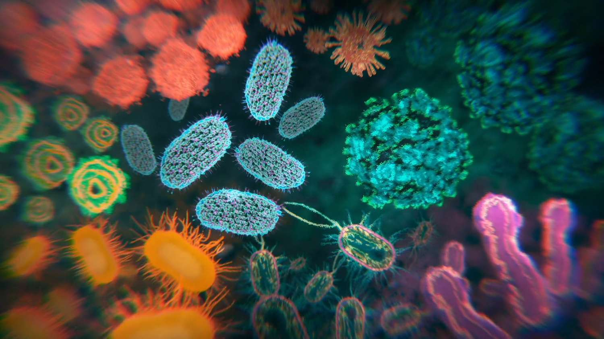
Concepts
Berens, A.E., Jensen, S.K.G. & Nelson, C.A. Biological embedding of childhood adversity: from physiological mechanisms to clinical implications. BMC Med 15, 135 (2017). https://doi.org/10.1186/s12916-017-0895-4
Notes:
Crf corticotropin rreleasing factor acth adrenocorticotropic hormone Epigenetic clock scores (define epigenetics as dna transcription regulation through methylation and acetylation of dna), biological age vs chronological age, telomere length (repetitive dna sequences at ends of chromosomes that shorten with each cell division until cell death) sorter telomeres indicate more rapid agind and predict mortality, cancer, and cvd. Optimism (less cellular aging) and sense of purpose (epigenetic aging) relate to these. Metabolome (peptide, amino acid, nucleic acids as signature of biochemical activity), microbiome; mitochcondrial health

Slide 14
Social Data
Concepts
Bio Data
Context, Experience, Behavior, Relations:
Where do people live
With whom do they interact
What challenges they face
Subjective-ish, Self-report
Field Data, Population Surveys
Large, More Diverse Samples
Causal Inference
Anthropology, Demography, Economics, Sociology, Psychology, Social Work, Political Science, Geography
Health, Growth, Aging, Function:
How healthy are folks
How do folks meet developmental milestones
How do they buffer stress
Objective-ish, Direct Measure
Lab Data, Limited Generalizability
Smaller Samples
Causal Testing
Medicine, Physiology, Biology, Nursing, Genetics, Biochemistry, Microbiology, Epidemiology
Notes:
social context, experience, behavior

Slide 15
Why lean on biological variables?
Concepts
Establish causality: Biosocial interactions are key to understanding human behavior, development, and health.
Compelling evidence: Biological concepts and methods can attest to the importance of social and contextual factors.
Motivates action: Public opinion and decision makers respond to tangible concrete evidence.
Policy evaluation: Biological data can forecast results on mortality gaps, spill over effects on health, cost/benefit argument.
Sensitivity: Biological data can be sensitive to preclinical periods and effects below perception.
Spot Risk Prior to Disease: Who is at risk? What exacerbates and ameliorates risk? What are the physiological pathways?
Inequity Issues: Physiologic data can reveal the hidden toll that discrimination takes on the bodies of individuals who may be marginalized.
Inform the Nature and Nurture Debate: We can’t understand gene regulation without reference to experience and context.
Avoid victim-blaming approaches: Strengths-based approaches can inform efforts to towards positive health and eliminate disparities.
McDade, T.W., Harris, K.M. From society to cells and back again: new opportunities for discovery at the biosocial interface. Discov Soc Sci Health 2, 4 (2022). https://doi.org/10.1007/s44155-022-00007-z
Notes:
Subclinical information, pathophysiological processes before the emergence of clibnicall disease (lipids, CRP, BP),
, they only matter if they are expressed, and expression is influenced by the environments—past and present.
Genome sequencing alone is poor information. The genome is a substrate of the environment, it takes up information from the environment to express itself or not. Positive Biology.

Slide 16
MEASURES

Slide 17
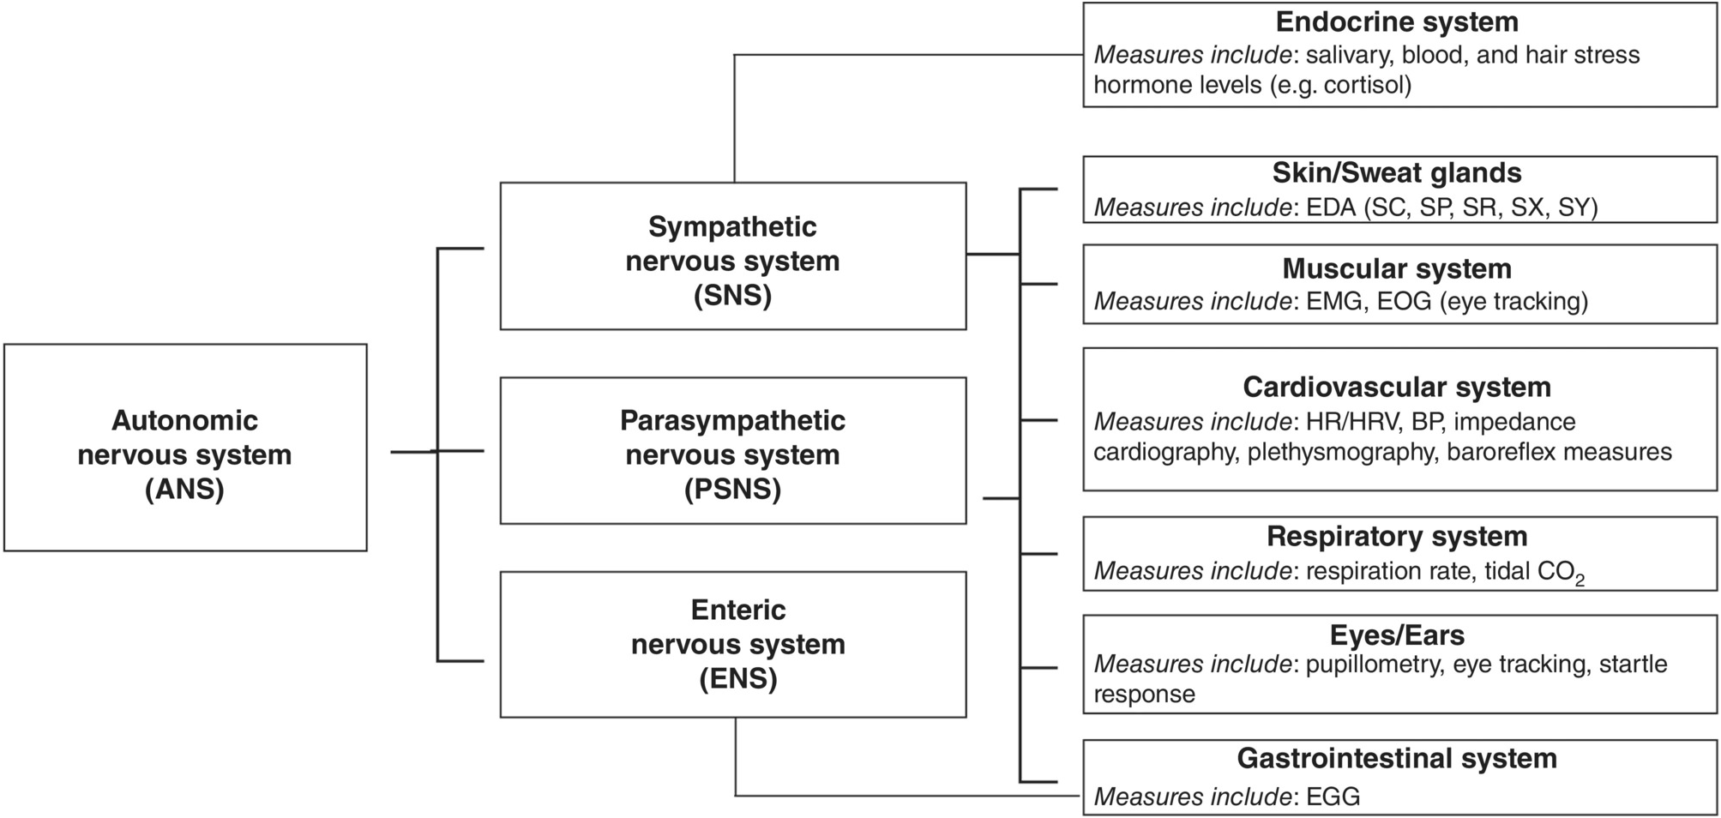
So how do we get psychophysiological data?
Measures
Levinson A, Hajcak G. Peripheral Psychophysiology. In: Wright AGC, Hallquist MN, eds. The Cambridge Handbook of Research Methods in Clinical Psychology. Cambridge Handbooks in Psychology. Cambridge University Press; 2020:118-135.
Notes:
Sc: skin conductance sp: skin potential sr: skin conductance response sx: ascending slope - activation sy: descending slope - recovery

Slide 18
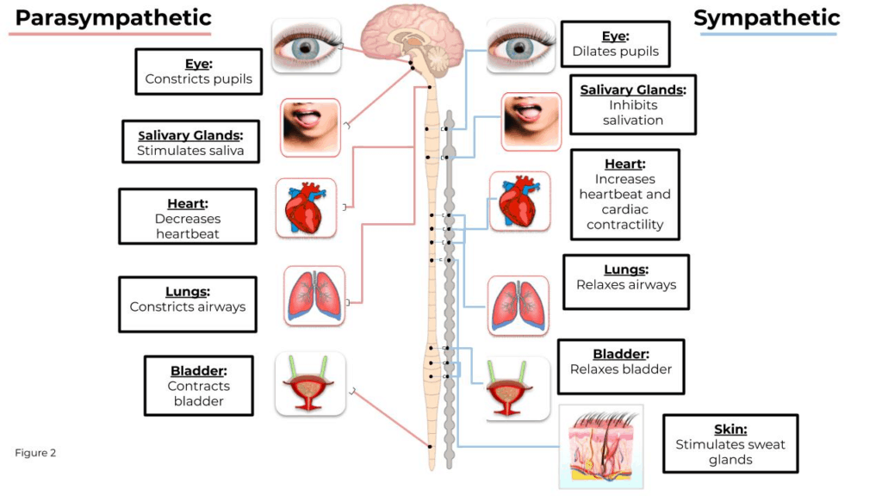
Measures
Mindware

Slide 19
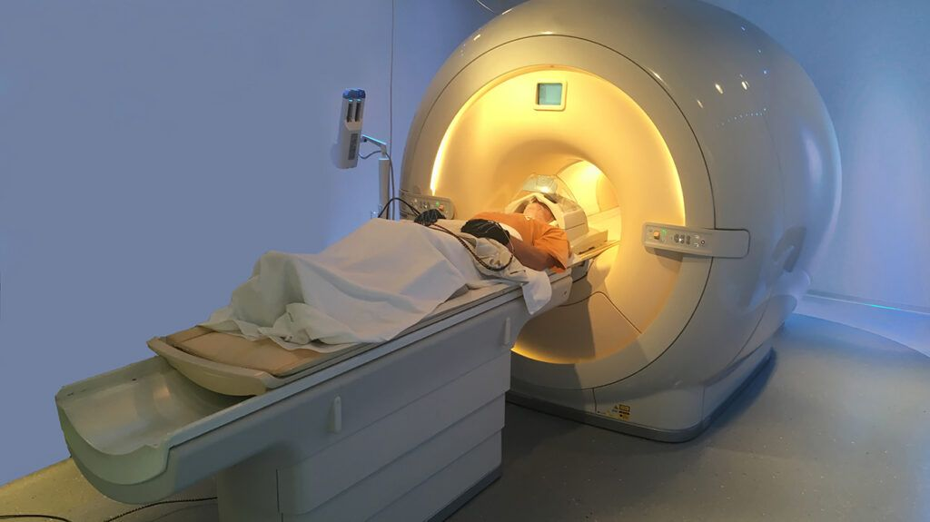
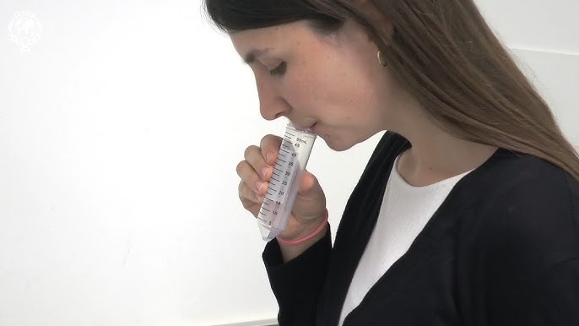
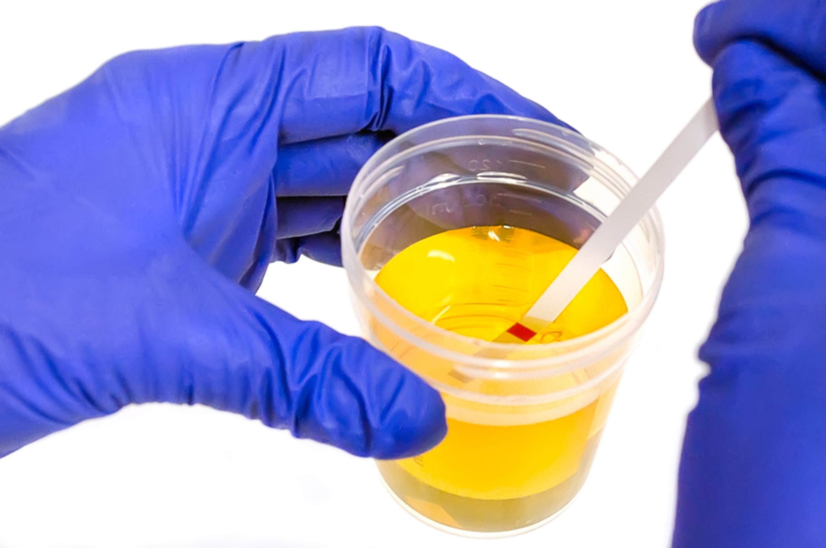
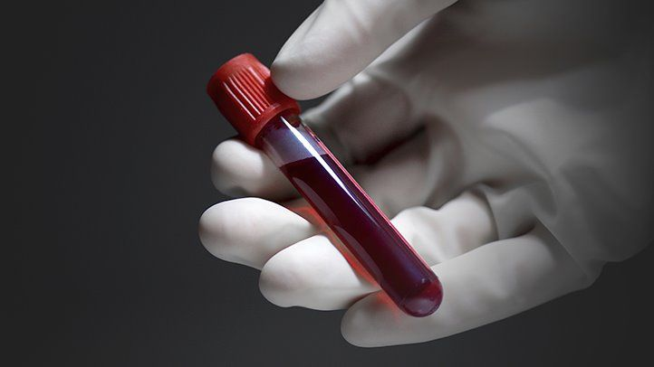
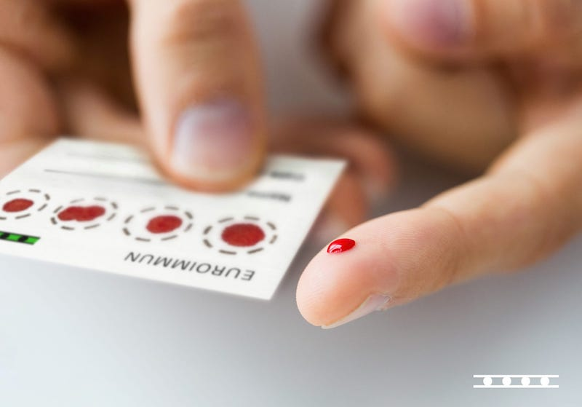
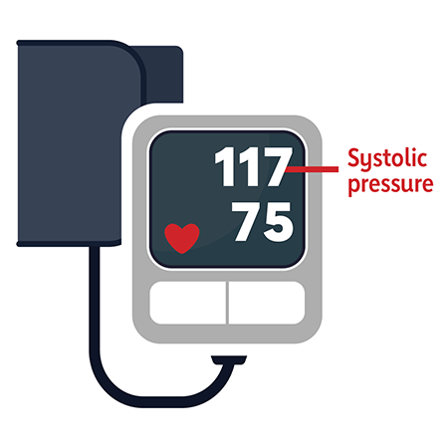
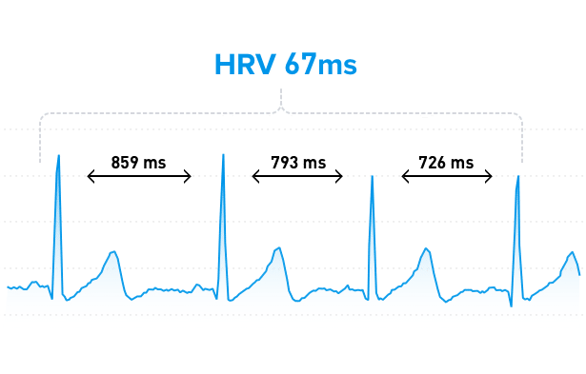
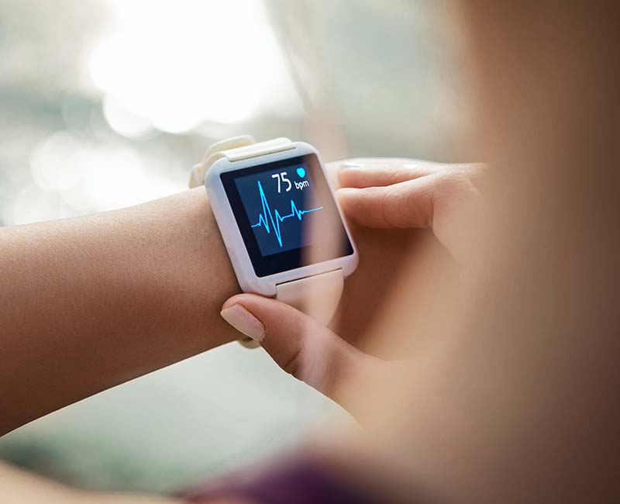
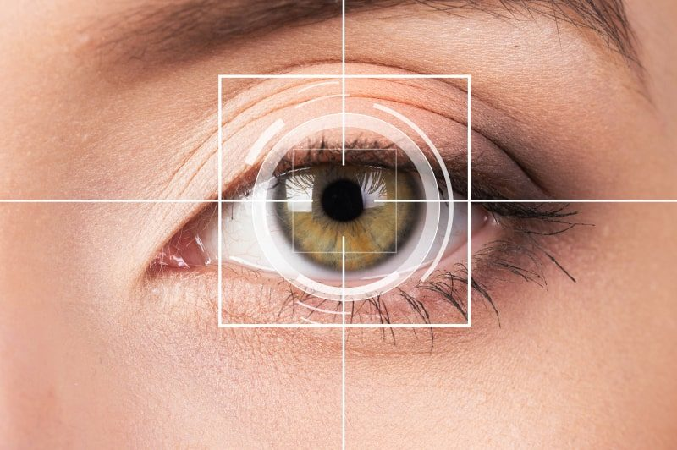
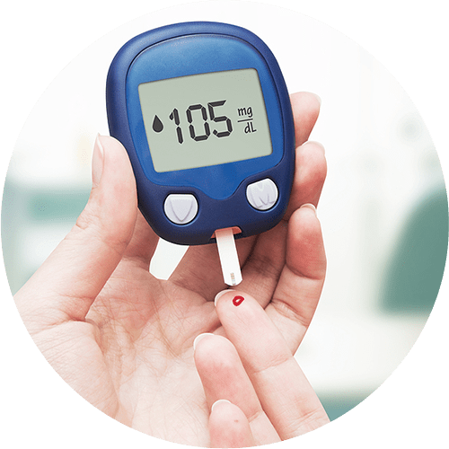
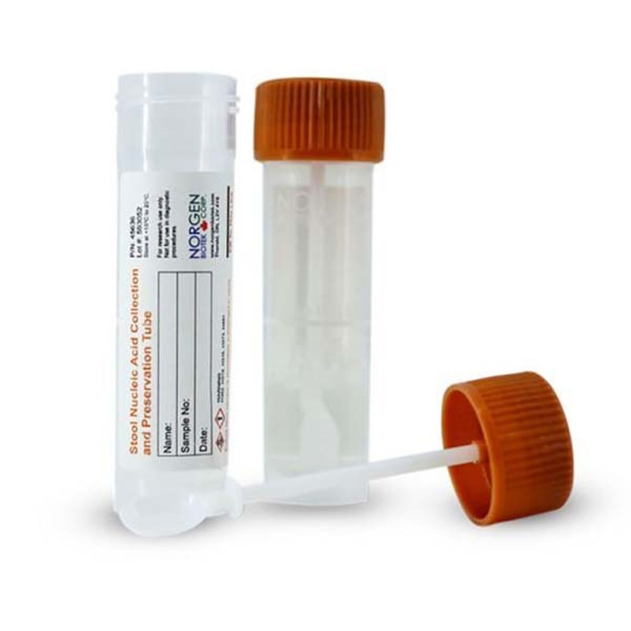
Measures
Berens, A.E., Jensen, S.K.G. & Nelson, C.A. Biological embedding of childhood adversity: from physiological mechanisms to clinical implications. BMC Med 15, 135 (2017). https://doi.org/10.1186/s12916-017-0895-4
Notes:
Epigenetic clock scores (define epigenetics as dna transcription regulation through methylation and acetylation of dna), biological age vs chronological age, telomere length (repetitive dna sequences at ends of chromosomes that shorten with each cell division until cell death) sorter telomeres indicate more rapid agind and predict mortality, cancer, and cvd. Optimism (less cellular aging) and sense of purpose (epigenetic aging) relate to these. Metabolome (peptide, amino acid, nucleic acids as signature of biochemical activity), microbiome; mitochcondrial health

Slide 20
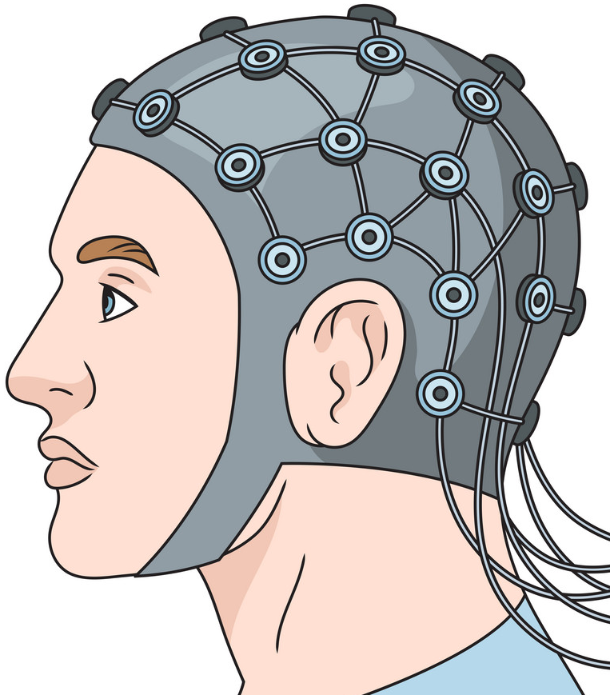
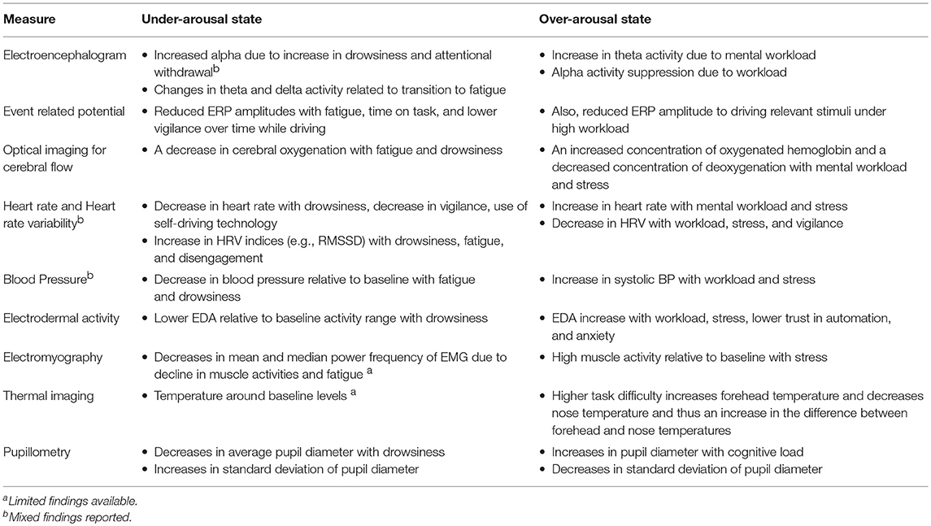
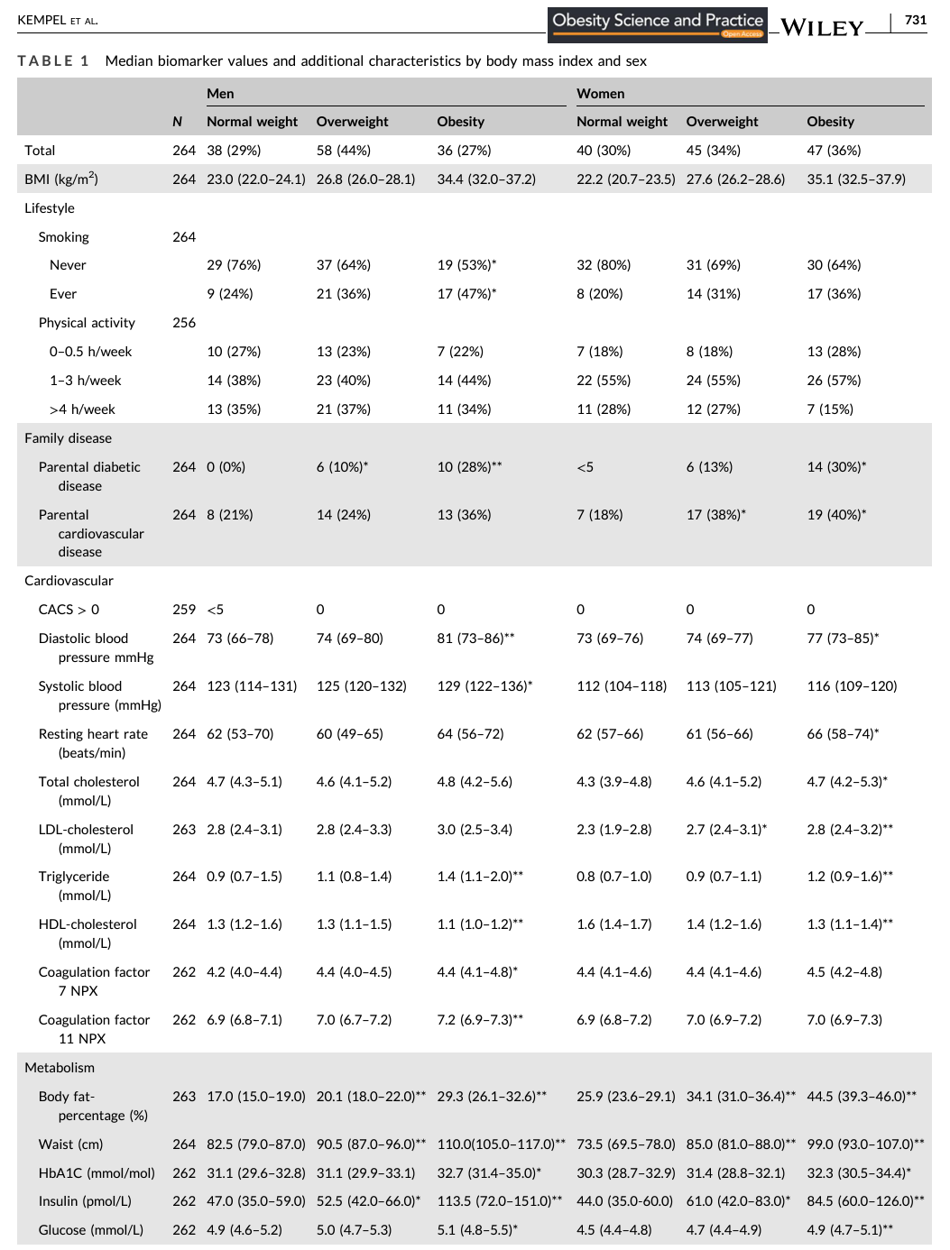
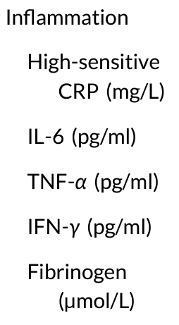
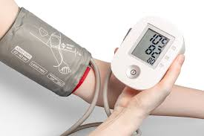
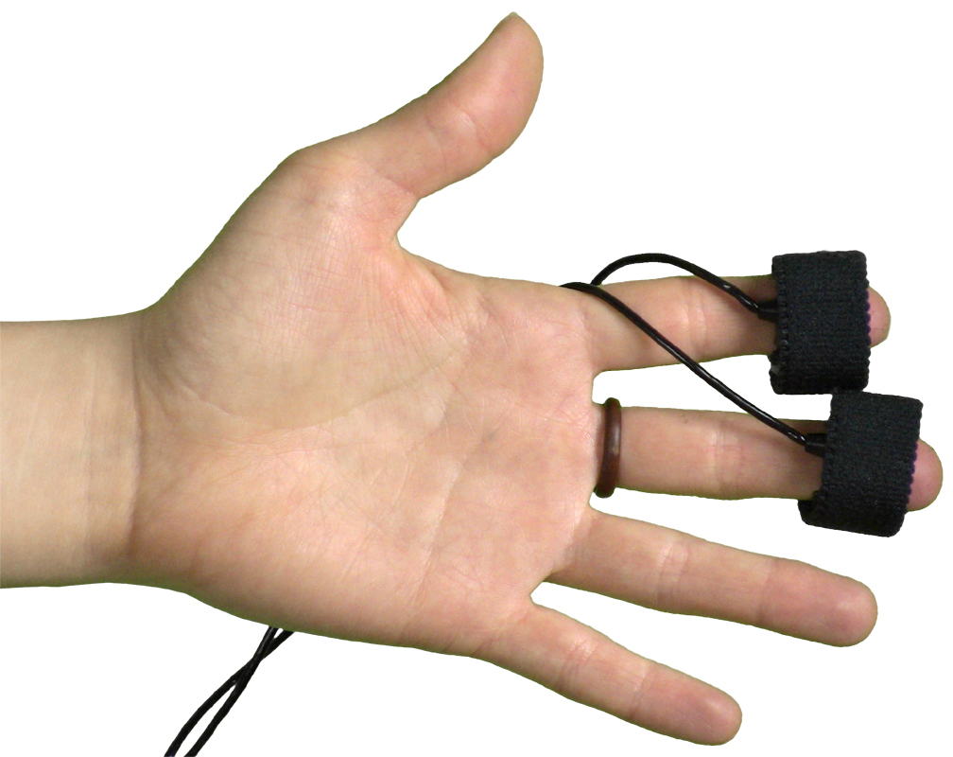
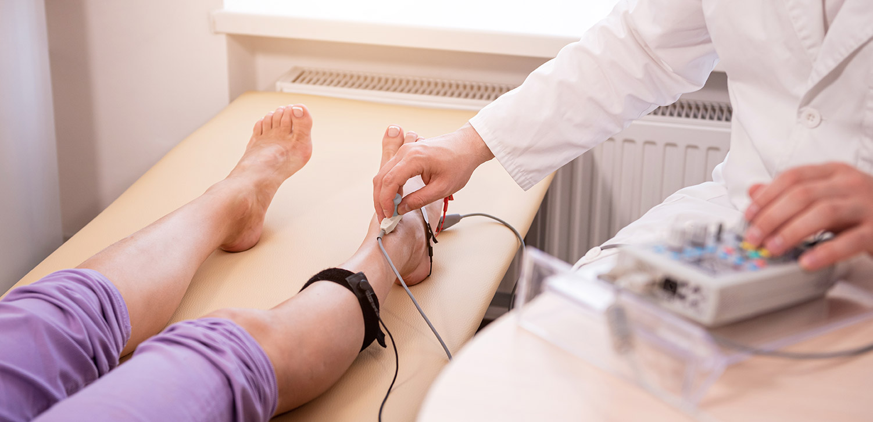

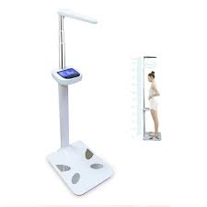
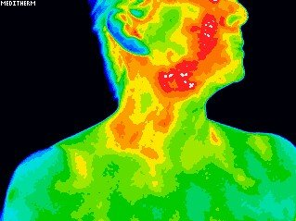
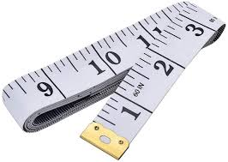
A moment vs A Lifetime
Measures
Lohani Monika, Payne Brennan R., Strayer David L., A Review of Psychophysiological Measures to Assess Cognitive States in Real-World Driving, Frontiers in Human Neuroscience, 13 2019, https://www.frontiersin.org/journals/human-neuroscience/articles/10.3389/fnhum.2019.00057, 10.3389/fnhum.2019.00057, 1662-5161
Kempel MK, Winding TN, Lynggaard V, Brantlov S, Andersen JH, Böttcher M. Traditional and novel cardiometabolic risk markers across strata of body mass index in young adults. Obes Sci Pract. 2021 Jun 1;7(6):727-737. doi: 10.1002/osp4.528. PMID: 34877012; PMCID: PMC8633932.
Notes:
Kempel MK, Winding TN, Lynggaard V, Brantlov S, Andersen JH, Böttcher M. Traditional and novel cardiometabolic risk markers across strata of body mass index in young adults. Obes Sci Pract. 2021 Jun 1;7(6):727-737. doi: 10.1002/osp4.528. PMID: 34877012; PMCID: PMC8633932.

Slide 21
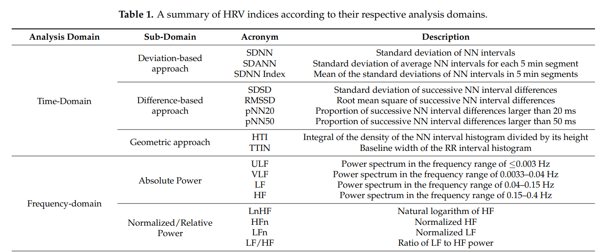
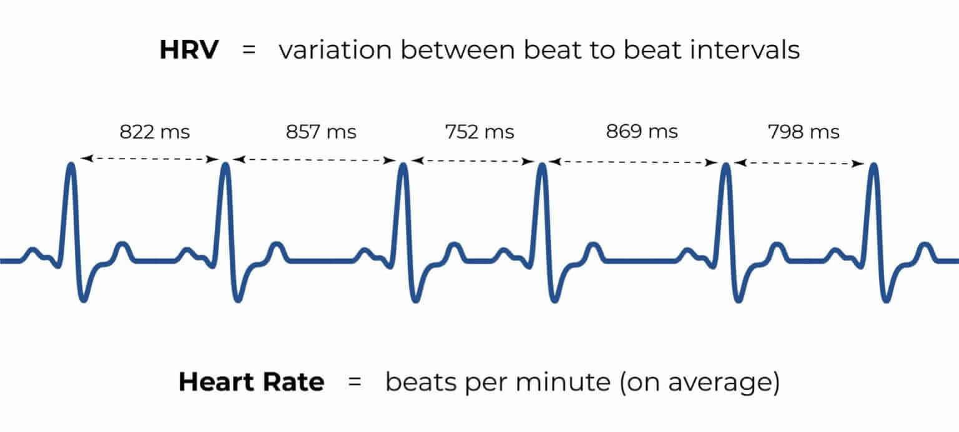
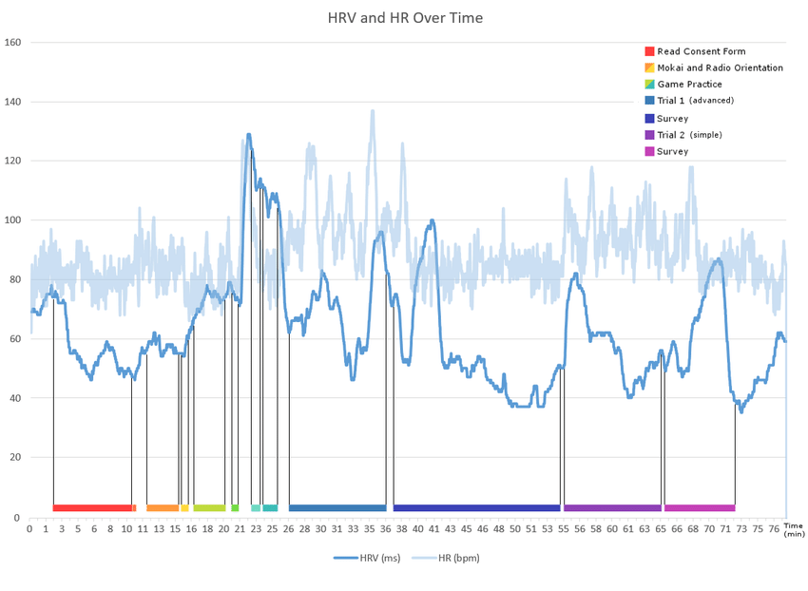
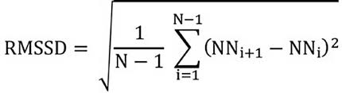
Heart: Heart Rate, and Heart Rate Variability
Measures
Pham, T., Lau, Z. J., Chen, S. A., & Makowski, D. (2021). Heart rate variability in psychology: A review of HRV indices and an analysis tutorial. Sensors, 21(12), 3998.

Slide 22
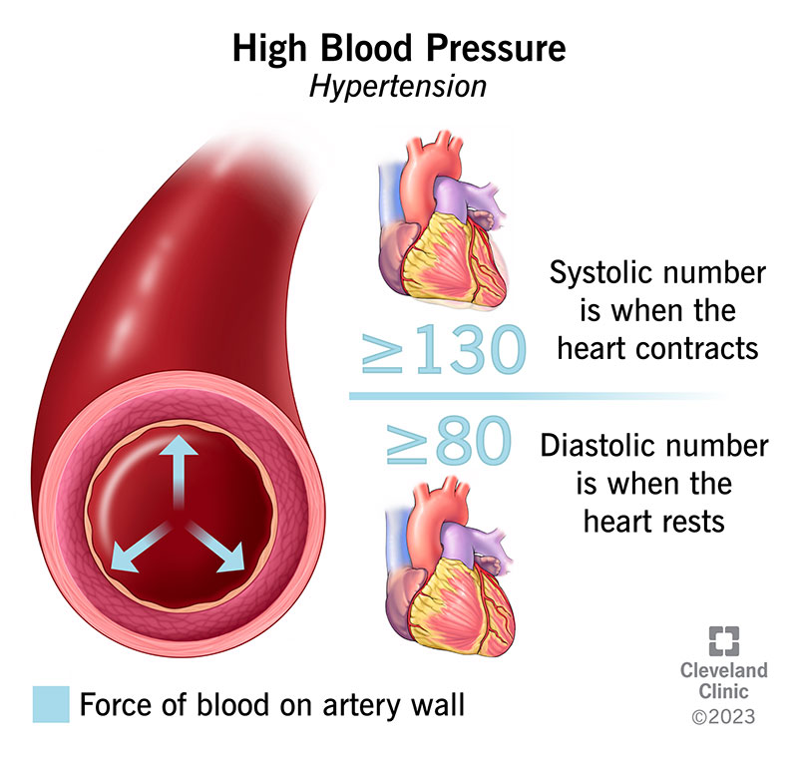
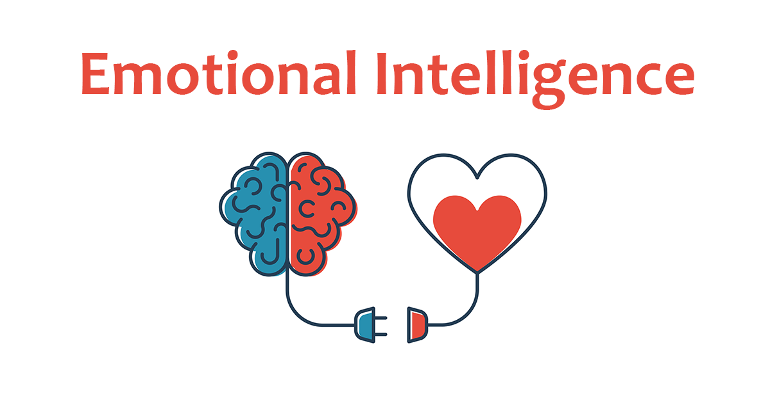

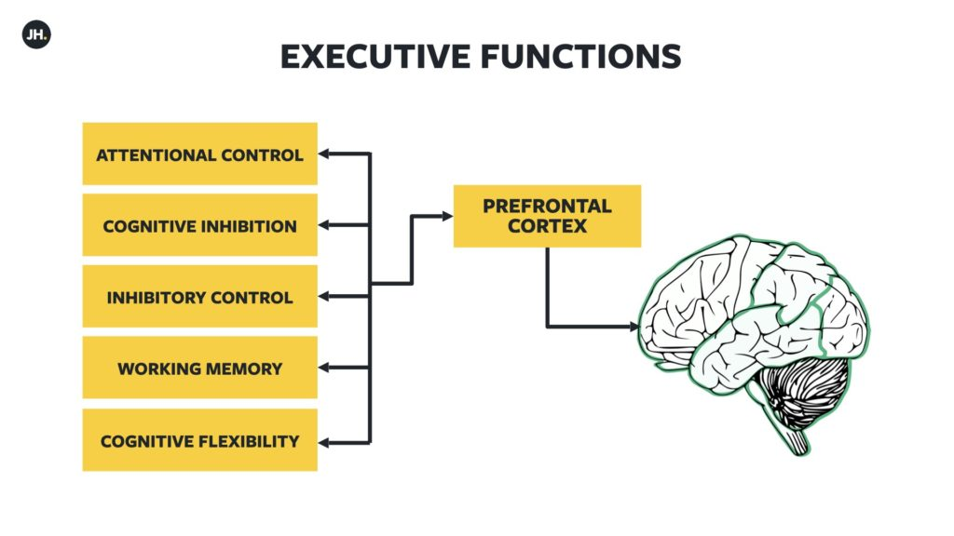

Heart: Heart Rate, and Heart Rate Variability
Negative Health Outcomes:
All-cause morbidity & mortality
CVD, Sudden death
Sleep HRV correlates with neighborhood disorder
Pain response (SES moderated)
Well-being:
Higher Meaning in Life
Emotional Intelligence
Self-Compassion
Cognition:
Cognitive Performance
Behavior:
Physical activity
Alcohol use
Smoking
Cooperative Behavior
Affect:
Social stress
Emotion reactivity to social evaluative stress
Social:
Childhood SES can predict higher recovery HR (moderated by psychological resources)
Britton, Annie; Hemingway, Harry, pp. 90-111, Heart Rate Variability in Healthy Populations: Correlates and Consequences, 9781405119603, https://doi.org/10.1002/9780470987483.ch11
Notes:
Tan, J.J.X., Tan, C.H. & Kraus, M.W. Subjective Socioeconomic Status Moderates How Resting Heart Rate Variability Predicts Pain Response. Affec Sci 5, 1–8 (2024). https://doi.org/10.1007/s42761-023-00234-wLischke, A., Jacksteit, R., Mau-Moeller, A., Pahnke, R., Hamm, A. O., & Weippert, M. (2018). Heart rate variability is associated with psychosocial stress in distinct social domains. Journal of psychosomatic research, 106, 56-61.
Boylan, J. M., Jennings, J. R., & Matthews, K. A. (2016). Childhood socioeconomic status and cardiovascular reactivity and recovery among Black and White men: Mitigating effects of psychological resources. Health Psychology, 35(9), 957.
Brice Beffara, Amélie G. Bret, Nicolas Vermeulen, Martial Mermillod, Resting high frequency heart rate variability selectively predicts cooperative behavior, Physiology & Behavior, Volume 164, Part A, 2016, Pages 417-428, ISSN 0031-9384, https://doi.org/10.1016/j.physbeh.2016.06.011.
Mellman, Thomas Alan, et al, Neighborhood stress and autonomic nervous system activity during sleep, 2018, 10.1093/sleep/zsy059

Slide 23
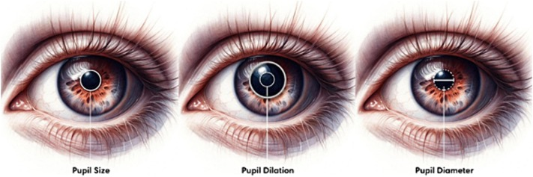
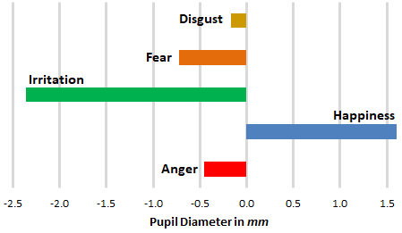

Eyes: Pupil Diameter
Measures
Pupil dilation and contraction as a physiological measure

Slide 24




Pupil Diameter
Measures
Affective State
Trust
Deception
Cognition
Attention and Interest (what is personally or socially relevant to us?)
Cognitive Load/Working Memory
Mental effort
Decision Making under risk (the riskier the decision the more dilation)
Problem Solving
Learning
Ambiguous language
Reactivity/Arousal
Orienting response
Effects of spatial characteristics (light, color) on cognitive processes
Mathôt S. (2018). Pupillometry: Psychology, Physiology, and Function. Journal of cognition, 1(1), 16. https://doi.org/10.5334/joc.18
Notes:
Hossain, G., & Yeasin, M. (2014). Understanding Effects of Cognitive Load from Pupillary Responses Using Hilbert Analytic Phase. 2014 IEEE Conference on Computer Vision and Pattern Recognition Workshops, 381-386.
Stolte, Moritz & Gollan, Benedikt & Ansorge, Ulrich. (2020). Tracking visual search demands and memory load through pupil dilation. Journal of Vision. 20. 21. 10.1167/jov.20.6.21.

Slide 25



Skin: Skin Conductance
Measures
Electrodermal Activity (EDA)
Galvanic Skin Response (GSR)
Variation of the electrical conductance of the skin in response to sweat secretion.
Our fingers, palms, head and the soles of our feet: very high density of eccrine glands (400/cm2)
microsiemens (µS)

Slide 26


Measures

Slide 27





Skin: Skin Conductance
Measures
Arousal:
Detect increased physiological sensitivity (response to trauma related cues in PTSD)
Affective State:
Stress reactivity (objective measure of emotional intensity)
Arousal response when exposed to aggressive or confrontational stimuli
Deception
Cognitive:
Risk in Decision Making (risky financial situations)
Cognitive effort and attention (multitasking, complex problem solving)
Social:
Empathy through synchronicity, social bonding
Moral:
Moral dilemmas
Harm
Moral transgression (what constitutes one?)
Kreibig, S. D. (2010). Autonomic nervous system activity in emotion: A review. Biological Psychology, 84(3), 394-421. https://doi.org/10.1016/j.biopsycho.2010.03.010,
Notes:
Kreibig, S. D. (2010). Autonomic nervous system activity in emotion: A review. Biological Psychology, 84(3), 394-421. https://doi.org/10.1016/j.biopsycho.2010.03.010, Critchley, H. D., Mathias, C. J., & Dolan, R. J. (2001). Neural activity in the human brain relating to uncertainty and arousal during anticipation. Neuron, 29(2), 537-545. https://doi.org/10.1016/S0896-6273(01)00225-2, Palumbo, R. V., Marraccini, M. E., Weyandt, L. L., Wilder-Smith, O., McGee, H. A., Liu, S., & Goodwin, M. S. (2017). Interpersonal autonomic physiology: A systematic review of the literature. Personality and Social Psychology Review, 21(2), 99-141. https://doi.org/10.1177/1088868316628405, Kivikangas, J. M., Kätsyri, J., Järvelä, S., & Ravaja, N. (2016). Emotions in virtual environments: The role of social and physical presence. Computers in Human Behavior, 64, 724-733. https://doi.org/10.1016/j.chb.2016.07.004, Critchley, H. D. (2002). Electrodermal responses: What happens in the brain. The Neuroscientist, 8(2), 132-142. https://doi.org/10.1177/107385840200800209, Orr, S. P., Metzger, L. J., Lasko, N. B., Macklin, M. L., Hu, F. B., & Pitman, R. K. (2000). Physiologic responses to sudden, loud tones in monozygotic twins discordant for combat exposure: Association with PTSD. Archives of General Psychiatry, 57(11), 1051-1057. https://doi.org/10.1001/archpsyc.57.11.1051, Moretto, G., Dragone, D., & di Pellegrino, G. (2009). The moral brain: An fMRI investigation of the cognitive and emotional aspects of moral decision-making. Cognitive, Affective, & Behavioral Neuroscience, 9(3), 225-232. https://doi.org/10.3758/CABN.9.3.225

Slide 28

Multisystemic Measures

Slide 29
TECHNOLOGY

Slide 30



Equipment
Technology
In lab
BIOPAC
EyeLink
Shimmer3, Plux Biosignal
In field
Wearables
Fitbit
Phone apps
Welltory
$4 000 - $20 000
Affect and Cognition Lab, Human Development
Co-PIs: Adam Anderson, PhD and Eve de Rosa, PhD
Notes:
BIOPAC CHANNELS: ECG, HRV, EEG, EMG, EGG at 100 kHz per channel, electrodes, amplifiers, transducers

Slide 31

Equipment
Technology
In lab
BIOPAC
EyeLink
Shimmer3, Plux Biosignal
In field
Wearables
Fitbit
Phone apps
Welltory
$10 000 - $40 000
Functional Magnetic Resonance Imaging Facility
College of Human Ecology
Contact: Dr. Henning Voss
Notes:
BIOPAC CHANNELS: ECG, HRV, EEG, EMG, EGG at 100 kHz per channel, electrodes, amplifiers, transducers

Slide 32


Equipment
Technology
In lab
BIOPAC
EyeLink
Shimmer3, Plux Biosignal
In field
Wearables
Fitbit
Phone apps
Welltory
$700
$200
Notes:
Ppg and eda

Slide 33


Equipment
Technology
In lab
BIOPAC
EyeLink
Shimmer3, Plux Biosignal
In field
Wearables
Fitbit
Phone apps
Welltory
$100
Free
Bronfenbrenner Center for Translational Research
Director: Anthony Burrow, PhD
Notes:
Ppg and eda

Slide 34

Software
Technology
Acqknowledge (BIOPAC)
Kubios
Data Viewer and Experiment Builder (Eye Link)

Slide 35

Software
Technology
Acqknowledge (BIOPAC)
Kubios
Data Viewer and Experiment Builder (Eye Link)

Slide 36

Software
Technology
Acqknowledge (BIOPAC)
Kubios
Data Viewer and Experiment Builder (Eye Link)
$300

Slide 37


Software
Technology
Acqknowledge (BIOPAC)
Kubios
Data Viewer and Experiment Builder (Eye Link)

Slide 38
Languages
Technology
Python, MatLab, R
Useful Packages: neurokit2 (Python)
Github Links: https://github.com/neuropsychology/NeuroKit
Sample Data: https://raw.githubusercontent.com/neuropsychology/NeuroKit/dev/data/bio_resting_8min_200hz.json

Slide 39
Available Longitudinal Data
Data Example
Community and population-based studies across life course
MESA Study
ABCD Study
The Avon Longitudinal Study of Parents and Children (ALSPAC)
Women’s Health Initiative
MIDUS
Household, Income and Labour Dynamics in Australia (HILDA) Survey

Slide 40

Evaluation

Slide 41

CCSS Other Resources
Request for data
https://socialsciences.cornell.edu/research-support/request-data

Slide 42

CCSS Other Resources
Data Archive
https://archive.ciser.cornell.edu/

Slide 43
Sources
https://www.census.gov/content/dam/Census/library/publications/2020/acs/acs_general_handbook_2020_ch09.pdf
https://usa.ipums.org/usa/
https://www.census.gov/data/what-is-data-census-gov/guidance-for-data-users/how-to-materials-for-using-data-census-gov.html

